Slide 1


Springboard Data Science Capstone Two Presentation By: Bini Teklehaimanot

Slide 2
Agenda
Problem Identification
Recommendation and Key Findings
Modeling Results and Analysis
Summary and Conclusion

Slide 3

Problem Identification
Goal: Investigate geographic disparities in healthcare access among Black Americans across all 50 U.S. states.
Focus Factors: Analyze correlations with the availability of primary care providers and household income levels.
Data Source: 2023 CDC National Health Interview Survey (NHIS) - Medicare & Medicaid respondents.
Outcome: Identify actionable patterns to inform equitable healthcare access strategies.
EDA Insight: Original occupation data was insufficient, leading to integration of CDC and ZIP-level data to align state and ZIP-only records. Early patterns were unclear, but correlation analysis revealed emerging trends. Key learning: improve memory and storage efficiency.

Slide 4

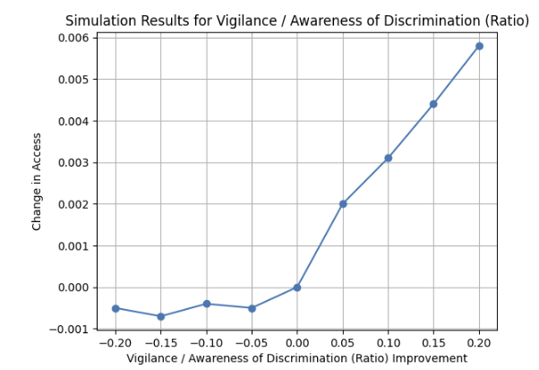
Recommendations and Key Findings
A 20% improvement in perceived safety from discrimination (i.e., reduced need for vigilance) leads to a 0.6% increase in healthcare access, double the gain compared to reducing experienced discrimination alone.
Even modest reductions in discrimination show measurable gains in access. A 20% decrease in discrimination leads to the largest positive shift in access, highlighting its critical role in healthcare equity.
Depression Events Need further Investigation

Slide 5

Modeling Results and Analysis
Model | MAE (CV Mean) | Std Dev (CV) | Test MAE | Notes
Linear Regression | 0.3179 | 0.0015 | 0.3214 | Worst performer in all metrics
Random Forest | 0.1052 | 0.0014 | 0.0766 | Best overall — highest accuracy, stability, and generalization
LightGBM | 0.1896 | 0.0009 | 0.1859 | Outperformed LR, but RF was more accurate and stable
Three algorithms tested on target feature access to healthcare
MAE was picked as the parameter across all models

Slide 6

Summary and Conclusion
Top Drivers of Access (Medicare Population): Among Medicare patients, wellness score, sex, and marital status emerged as the most influential predictors of access.
Discrimination & Vigilance Matter: Experienced discrimination and vigilance remain key factors, reinforcing the role of perceived bias in access disparities.
Other Notables: Mental health (e.g., depev, hearingdf), race, and education-level proxies also contributed meaningfully. Surprisingly, provider density and cost-sharing variables had lower predictive value.

